Slide 1
Cloud Computing and Cloud Networking
Winter 2025
K. K. Ramakrishnan
kk@cs.ucr.edu
SSC 308
Tue-Thur 2:00 pm - 3:20 pm

Slide 2
CS 208: Class 6 Live Migration of Virtual Machines
Slides from a number of papers & presentations:
1) Christopher Clark, Keir Fraser, Steven Hand, Jacob Gorm Hansen, Eric Jul, Christian Limpach, Ian Pratt, Andrew Warfield
University of Cambridge Computer Laboratory UK & Department of Computer Science University of Copenhagen
Live migration of virtual machines
NSDI 2005 (https://www.usenix.org/legacy/events/nsdi05/tech/full_papers/clark/clark.pdf)
2) Post-copy Live Migration of Virtual Machines by Michael Hines, Umesh Deshpande, and Kartik Gopalan from Binghamton University: [VEE 2009]
3) Black-box and Gray-box Strategies for Virtual Machine Migration by Timothy Wood, Prashant Shenoy, Arun Venkataramani, and Mazin Yousif, NSDI 2007

Slide 3
Motivation
Why do we need live migration?
We want to move a VM without interrupting the VM’s service.
Products (some from many years ago):
Xen 2.0 : live migration
VMware:Vmotion
Container migration: Docker CRIU (‘live’ is still a ‘work in progress’)
Checkpoint/Restore In Userspace (CRIU)

Slide 4

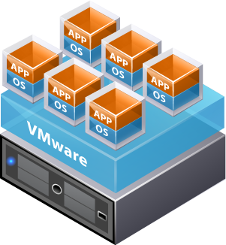
Server Consolidation
Can pack lots of VMs onto a server
e.g., different websites have workload peaks at different times, so we can share resources in a datacenter’s server(s)
Placement problem:
Data center has 10,000 - 1,000,000 servers
Customers have 100,000s VMs
Each with different CPU and RAM needs
Which VMs should go where?
How hard is this problem?
Often use bin packing algorithms
But imbalance may result from imperfect predictions, variability

Slide 5
VM Checkpointing
What is a computer?
What is its "state"?
How can we save a computer to disk?
Why would we want to?

Slide 6
VM Checkpointing
A VM is really just (memory + CPU + disk) state
Save a copy of a VM:
Pause VM
Write out all of its memory pages to disk
Write out processor (e.g., registers) state
Make a copy of its disk data
Can restore it later, at exactly the point where it was paused
Or create multiple clones based on this saved state
VM
Memory state
CPU state

Slide 7
VM Migration
Virtualization abstracts the VM from the underlying hardware...
So we can change the hardware completely without affecting the VM
Live VM Migration: transferring a live VM from one computer to another
VM doesn't realize it is being moved
Network connections to the VM aren't interrupted
Users and applications should be able to continue (mostly) unaffected

Slide 8



VM Migration
Assume disk is accessible to both hosts over network
Only need to migrate memory and CPU state
Basic idea for Live Migration:
Copy all memory pages as the VM is running
Track what memory pages are written to by the VM during transfer
Resend all dirty pages.
Repeat until there are very few pages left.
Pause and send the final set of pages
time
VM Memory
VM Memory
Copy All Pages
...
Iterate: Copy dirtied pages
Host 1
Host 2

Slide 9
Significance of Live Migration
Concept:
Migration: Move VM between different physical machines
Live: Without disconnecting client or application (invisible)
Relation to Cloud Computing and Data Centers:
Cloud Infrastructures and data centers have to efficiently use their huge scale of hardware resources.
Virtualization Technology helps in two approaches:
Server Consolidation
Live Migration (e.g., for load balancing)
Roles in a Data Center:
Flexibly remap hardware among VMs.
Balance workload
Save energy
Enhance service availability and fault tolerance

Slide 10
Considerations for Live Migration
Scale and frequency leads to a significant Live Migration cost
Cost is a function of Scale, Frequency and Cost.
S(Scale): How many servers? (very old numbers)
Google: Estimated 200,000 to 500,000 servers, included in 36 data centers in 2008
MS: Added 10,000 servers per month in 2008
FaceBook: More than 30,000 servers in its data center in 2008
All of these have likely grown by an order of magnitude in the last 10 years.
F(Frequency): How often does it happen?
Load balancing
Online maintenance and proactive fault tolerance
Power management
C(Cost of Live Migration):
Hardware and network bandwidth：save and transfer VM state
Workload performance: share hardware
Service availability: downtime

Slide 11
Introduction: Original Idea
Fundamental Idea: Live OS migration
Migrating an entire OS and all of its applications as a unit
Memory state can be transferred in a consistent and efficient fashion
Allow a separation of concerns between the users and operator
Minimize the downtime and total migration time
Example: Pre-copy approach

Slide 12
Related Work (in addition to Xen’s)
Vmotion
Process Migration
Residual dependency
an ongoing need for a host to maintain data structures or provide functionality for a process even after the process migrates away from the host

Slide 13

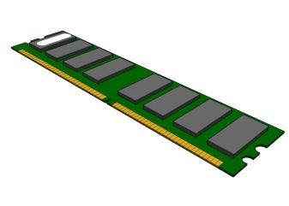

Live VM Migration
Migration of a running Virtual Machine between physical hosts
Live VM migration usually involves
Migrating memory state
Migrating CPU state
Optionally, migrating virtual disk state
CPU states
Memory
Disk Image

Slide 14
Why Live Migrate VMs?
Load Balancing
System Maintenance
In anticipation of hardware failure or natural disaster
Edge computing
To move computation closer to the data sources
Avoiding residual dependencies at source host which occurs with a process migrating to another node
E.g. system call redirection, shared memory

Slide 15
Performance metrics of Live Migration
Minimizing Downtime
Reducing total migration time
Avoiding interference with normal system activity
Minimizing network activity

Slide 16
Metrics
Metrics and Measurement:
Downtime
Def: how long the VM is suspended
Measure: ping
Total migration time
Def: how long a Live Migration(LM) lasts
Measure: timing the LM command
Amount of migrated data
Def: how much data is transferred
Measure: transferred data on its exclusive TCP port
Migration overhead
Def: How much LM impairs performance of the normal workload
Measure: Reduced percentage of the workloads’s score in a benchmark
Metrics Sufficiency:
Cost :
migration overhead,
amount of migrated data (burden on network)
QoS:
downtime,
total migration time
migration overhead,

Slide 17
Migrate VM’s memory first or last?
Pure stop-and-copy
Freeze VM at source,
Copy the VM’s pseudo-physical memory contents to target,
Restart VM at target
Long downtime.
Total migration time = downtime
Pure Demand Paging
Freeze VM at source,
Copy minimal execution context to target
PC, Registers, non-pageable memory
Restart VM at target,
Pull memory contents from source as and when needed
Smaller downtime
Sloooow warm-up phase at target during page-faults across network

Slide 18
Design(1) - Migrating Memory
Steps for Pre-Copy and Post-Copy based Live Migration Approaches
Minimize both downtime and total migration time
Downtime – the period during which the service is unavailable
Total Migration Time – the duration between when migration is initiated and when the original VM can be discarded

Slide 19
Design(2) - Migrating Memory
Three phases of memory transfer
Push phase
Source VM continues running
Pages are pushed across the network to destination
Stop and copy phase
The source VM stopped, pages are copied across to the destination VM
Pull phase
New VM executes and find faults
“Pull” pages from the source
Pre- copy
A bounded iterative push phase with a very short stop and copy phase
Avoids Pull phase

Slide 20
Design(3) – Network & Disk
Network
Generate an unsolicited ARP reply from the migrated host, advertising the IP has moved to a new location
A small number of in-flight packets maybe lost
Disk
Network-attached Storage(NAS)

Slide 21
Pre-copy Live VM Migration
1st Iteration
Transfers entire memory
2nd Iteration
Dirty Pages
Stop & copy Downtime
Preparation (live) – Push Phase
Resume time
DON’T freeze VM at source ➔Let it continue to run
Copy VM’s memory contents to target over multiple iterations
First iteration ➔ copy all pages. (original Xen: pause and take snapshot; later QEMU improved it - mark all pages ‘dirty’ to begin with).
Each subsequent iteration ➔ copy pages that were dirtied by the VM during the previous iteration
Do a short stop-and-copy when number of dirty pages is “small enough”.
But what if number of dirty pages never converges to a small enough number?
After a fixed number of iterations, give up and do a long stop-and-copy.

Slide 22
Design(4) – Logical Steps
VM running normally on Source Host
Overhead Due to copying
Downtime
(VM out of service)
VM running normally on Destination Host
Stage 0:
Pre-Migration
Stage 3:
Stop and copy
Stage 1:
Reservation
Stage 2:
Iterative
Pre-copy
Stage 4:
Commitment
Stage 5:
Activation

Slide 23
Design(5) – Logical Steps
Stage 0: Pre-Migration
Preselect target host
Stage 1: Reservation
Confirm the resources are available on destination host
Stage 2: Iterative Pre- copy
First iteration, all pages are transferred from source to destination
Subsequent iteration, copy dirty pages during the previous transfer phase

Slide 24
Design(6) – Logical Steps
Stage 3: Stop and copy
Stop the running Guest OS at source host
Redirect the network flow to destination host
CPU state and remaining memory pages are transferred
Stage 4: Commitment
Destination host indicates to source it has successfully received a consistent OS image
Source Host acknowledges and VM @ source now can be discarded
Stage 5: Activation
VM starts on Destination host

Slide 25
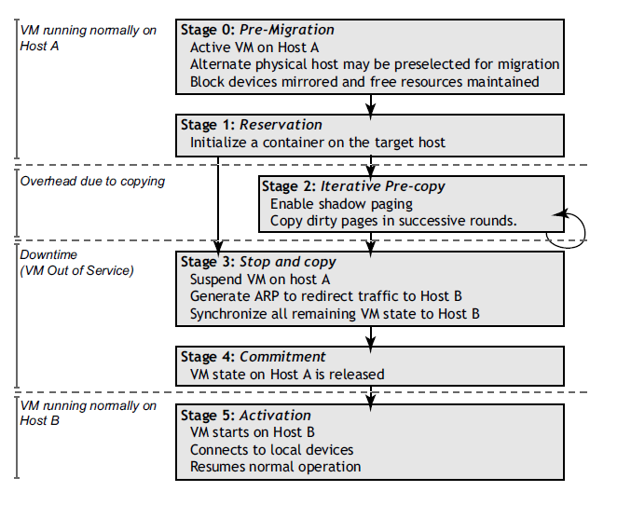
Pre-copy migration

Slide 26
Challenge in Pre-copy
Every VM has some set of pages which it updates very frequently.
And this ‘Working Set’ size would influence downtime of the migration.
Writable Working Set
The bandwidth of network also impacts the migration time.

Slide 27
Writable Working Set (WWS)
WWS
A certain set of pages will be written often
Based on the iteration time window
Should be transferred on every iteration of the ‘stop and copy’ phase (actually the iterative pre-copy phase)
Use Xen’s shadow page tables to track

Slide 28
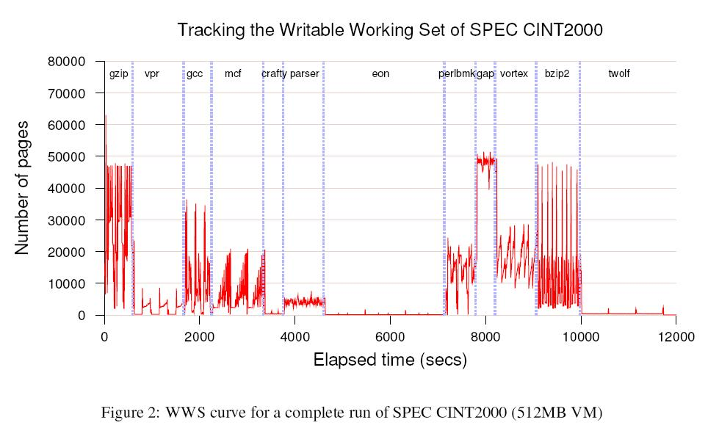

Slide 29
Implementation
There are two kinds of implementations of migration: for initiating and managing state transfer
Managed Migration
The physical machine has a management VM. (Xen)
A migration daemon running in the management VM
Self Migration
Implemented within the migrating (guest) OS
A small stub required on the destination machine
There are three conditions for changing to the stop-and-copy (iterative pre-copy) phase.
The dirty rate is bigger than an upper bound.
The size of working set is small enough.
A limit on the rounds.
Dirty Rate = (# Previous dirty pages) / (#duration of previous round)

Slide 30
Managed Migration(Xen)
1st round:
Copy all memory pages to destination machine.
Replace original page table with shadow page table, all of whose pages are marked read-only.
Create a dirty bit map for the VM.
2nd-(n-1)th round:
During the page transfers, if VM wants to modify a page, it will invoke Xen to set the appropriate bit in the dirty bit map.
Dirty pages will be resent again.
Reset dirty bit map for the next round.
nth round:
When the Dirty rate is bigger than upper bound, begin to do stop-and-copy.

Slide 31

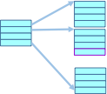
Tracking dirty pages
• Xen-based implementation • Page tables in Xen maintained by guest • Move to shadow page tables for migration • Migration managed by control software in domain0 • Shadow page table constructed on demand for every round • Dirty bitmap maintained for every round • Any page access by guest -> page fault to Xen, shadow page table updated • PTE marked as read-only by default in shadow • If valid write access, shadow PTE marked writeable, page marked dirty in bitmap • At end of round, dirty pages are marked for transfer in control software • Shadow page table and dirty bitmap reinitialized after every round • Last set of dirty pages copied in stop-and-copy • Guest page table in target host is changed based on new physical addresses
Guest Page Table
Shadow Page Table
in Xen

Slide 32
Self Migration
1st round:
Copy all memory pages to destination machine.
Mark all virtual addresses as write-protect.
The guest OS creates a dirty bit map (used in tracking physical pages) to track and remember the modified pages.
2nd-(n-1)th round:
During the page transfers, if write faults occur, the guest OS will set the appropriate bit in the dirty map.
Dirty pages will resent again.
Reset dirty bit map for the next round.
nth round:
When the dirty rate is bigger than the upper bound, OS would disable all activities.
Copy all dirty pages to shadow buffer.
Transfer the shadow buffer and ignore new page updates.

Slide 33
Implementation Issues(1)
Dynamic Rate - Limiting
Administrator decides a minimum(m) and a maximum(M) bandwidth limit
Transfer speed (v)
Every subsequent round calculate the dirtying rate (r)
r = dirty pages / duration of previous round

Slide 34
Implementation Issues(2)
Dynamic Rate - Limiting
The first round v = m (transfer rate = min. b/w)
Next round v = v*r (adjust transfer rate)
Pre-copy will be terminated when v > M or remaining pages less than 256KB

Slide 35
Implementation Issues(3)
Rapid Page Dirtying
The page dirtying is often physically clustered
“Peek” those pages dirtied in the previous round
Avoid transferring page multiple times • Before transmitting page, peek into the current round's dirty bitmap • Skip transmission if page is already dirtied in ongoing round
Stunning Rogue Process
Some processes may produce dirty memory at a fast rate
Ex. A test program which writes one word in every page was able to dirty memory at a rate of 320Gbit/sec
Forking a monitoring thread within the OS kernel when migrating begins
Monitor the Writeable WS of individual processes
If the process dirties memory too fast, then “stun” it
Move non-interactive processes generating dirty pages to wait queue • Execution paused until migration completes

Slide 36
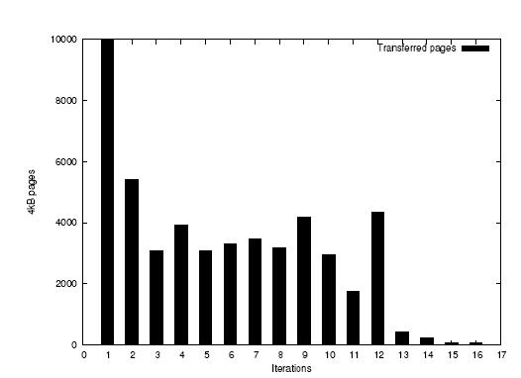

Slide 37
Implementation Issues(4)
Freeing Page Cache Pages
OS can tell some or all of the free pages to not be transferred
Page Cache: transparent cache for the pages originating from a secondary storage device - disk.
Do not transfer these pages in the first iteration
Reduce transferred time

Slide 38
Evaluation(1)
Dell PE-2650 server-class machine
Dual Xeon 2Ghz CPUs
2GB memory
Broadcom TG3 network interface
Gigabit Ethernet
Netapp F840 NAS
XenLinux 2.4.27

Slide 39
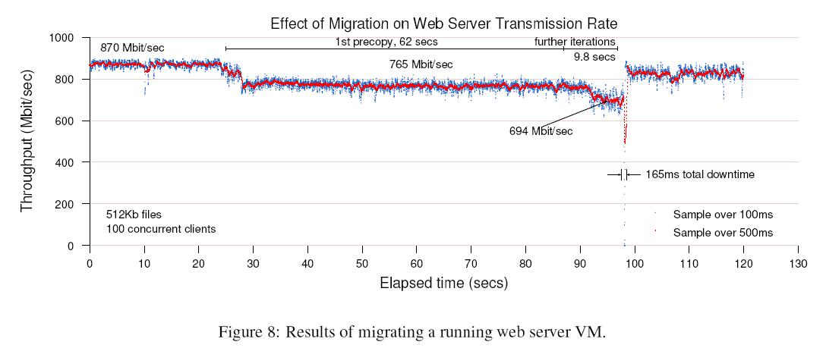
Evaluation(2)- Simple Web Server
Continuously serving a single 512KB file to a set of 100 clients

Slide 40
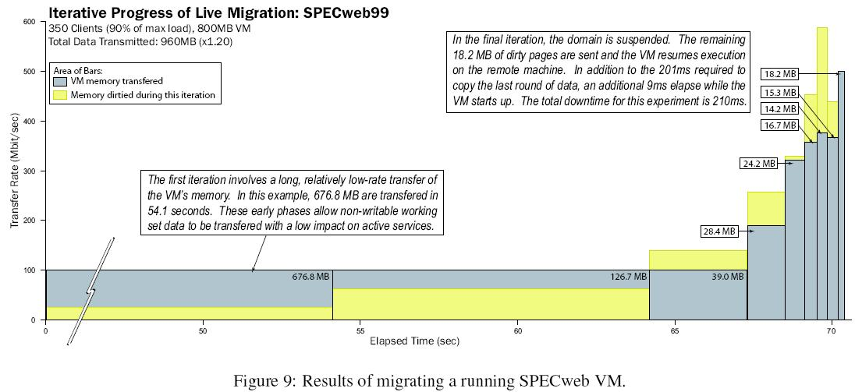
Evaluation(3)- SPECweb99
SPECweb99 – a application-level benchmark for evaluating web server

Slide 41
Evaluation(4)
Quake 3 server – an online game server with 6 players
Downtime: 50ms
Diabolical Workload
Running a 512MB host and use a simple program that writes constantly to a 256MB region of memory
Downtime : 3.5sec
Rare in real world

Slide 42
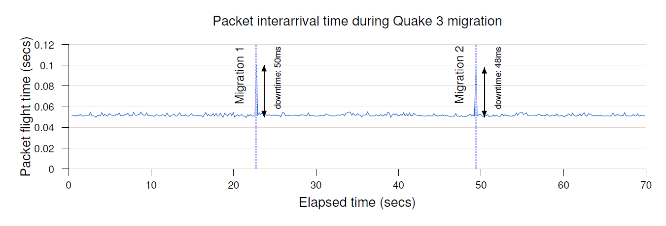
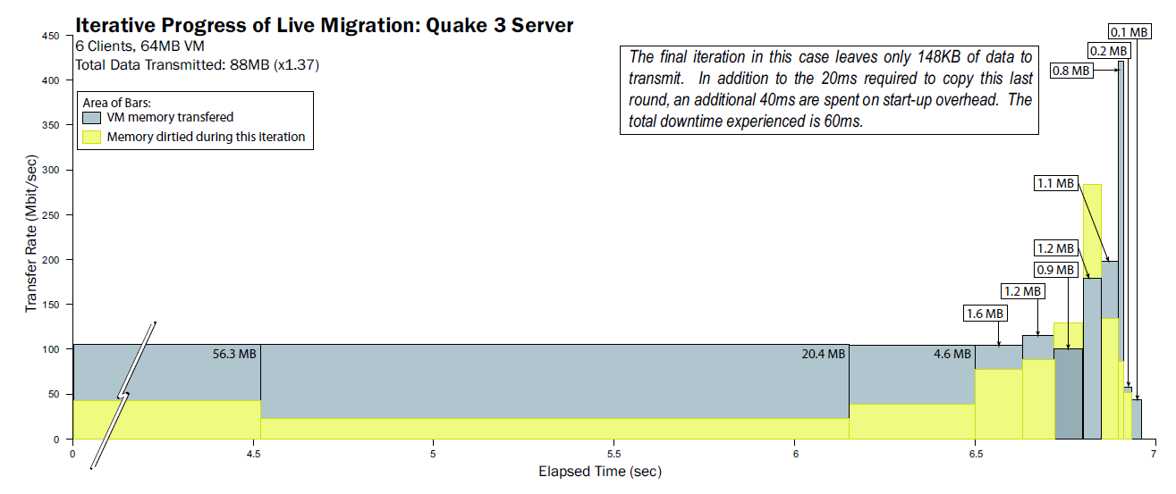

Slide 43
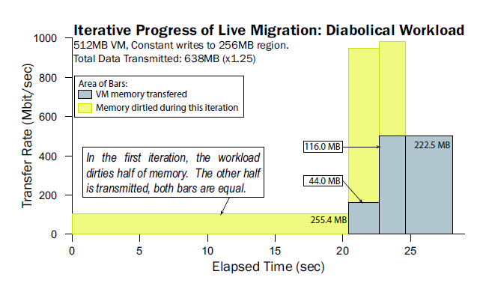
A worst case example

Slide 44
Summary
Minimal impact on running services
Small downtime with realistic server

Slide 45
Optimization
Dynamic Rate-Limiting
Rapid Page Dirtying
Para-virtualized Optimization
1. Ballooning mechanism
technique to dynamically adjust physical memory of guest.
driver in the guest OS, called a balloon driver, allocate pages from the guest OS and then hand those pages back to Xen.
From the guest OS perspective: has all memory that it started with; only there is a device driver - memory hog. But from Xen’s perspective, the memory which the device driver asked for is no longer real memory — it’s just empty space (hence “balloon”).
When the administrator wants to give memory back to VM, balloon driver asks Xen to fill the empty space with memory again (shrinking or “deflating” the balloon), and then “free” the resulting pages back to the guest OS (memory available for use again).
2. Stunning rogue Process

Slide 46
Postcopy

Slide 47
The catch in Pre-copy:
Dirty page tracking
Mark the VM’s memory pages as read-only after each iteration.
Trap write operations via hypervisor to track dirtied pages.
Reset after each iteration
Pre-copy works well as long as writes are infrequent
But for write-intensive workloads, copying iterations may never converge.

Slide 48
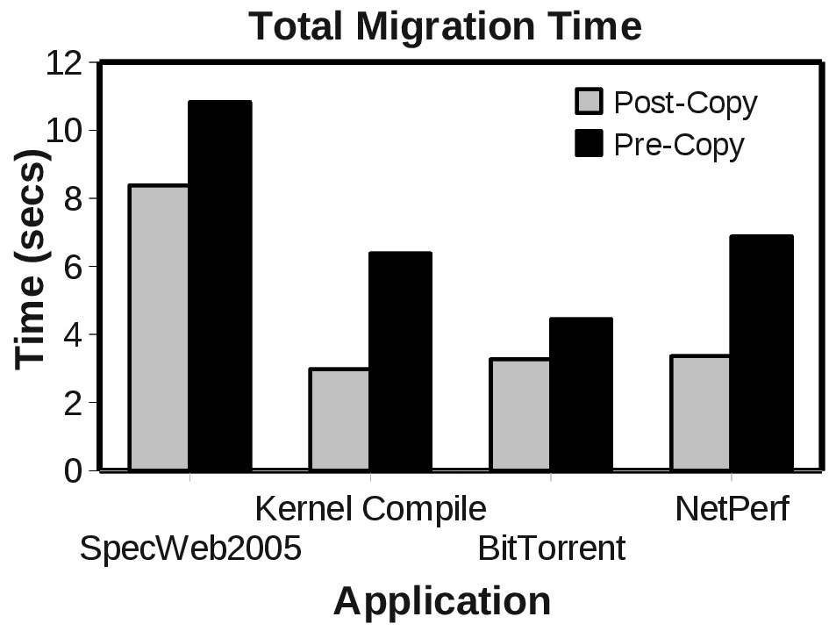
Postcopy Live Migration
Better for write-intensive workloads
Preparation
(live)
Resume Time (live)
Downtime
Active Push + Demand Paging
(Non-pageable
Memory e.g. guest
Kernel memory)
Advantage
Lower network overhead
Each page sent only once over the network
Total migration time lower for write-intensive workloads.
Disadvantage
Cold start penalty at the destination till working set is fetched over the network

Slide 49
Stages of Postcopy Migration
First, freeze the VM at the source
Migrate CPU state and minimum state to destination
Start VM at the target
but without its memory!
Fetch memory by one of two ways
Demand paging over network
Actively pushing from source
Hopefully pages will be pushed BEFORE they are demand paged
Causing few network-bound page faults from destination

Slide 50
Prepaging strategies for Post-copy
Goal: Reduce number of network-bound demand paging faults.
Bubbling: To proactively push pages around the faulted page
Pivot
VM Memory Pages
0
Max

Slide 51
Prepaging strategies for Post-copy
Goal: Reduce number of network-bound demand paging faults.
Bubbling: To proactively push pages from source around the most recent page fault.
Direction (uni/bi)
Number of pivots
0
Max
Size
LRU Ordering
50% reduction in network-bound page faults

Slide 52
Hybrid Live Migration
Balance between read-intensive and write-intensive workloads
Preparation
(live)
Resume Time (live)
Downtime
1st Iteration Pre-copy
Active Push + Demand Paging
(Non-pageable
Dirty Memory)
Versus Precopy
Lower total migration time
Versus Postcopy
Smaller cold-start penalty due to fewer network-bound page faults

Slide 53
Black-box and Gray-box Strategies for Virtual Machine Migration
Timothy Wood, Prashant Shenoy,
Arun Venkataramani, and Mazin Yousif*
University of Massachusetts Amherst
*Intel, Portland

Slide 54
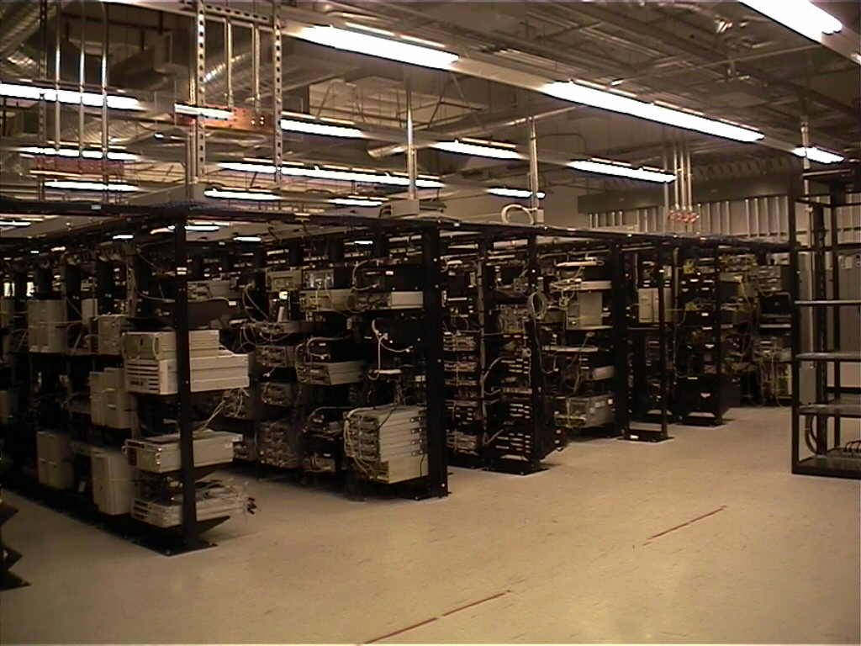
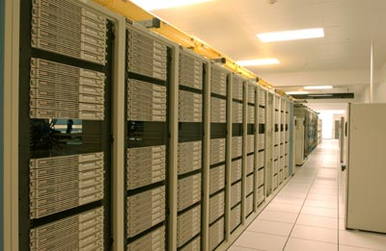
Enterprise Data Centers
Data Centers are composed of:
Large clusters of servers
Network attached storage devices
Multiple applications per server
Shared hosting environment
Multi-tier, may span multiple servers
Allocates resources to meet Service Level Agreements (SLAs)
Virtualization increasingly common
Notes:
The environment that I’m going to talk about today is an Enterprise data center. These data centers are composed of large clusters of servers, there could be hundreds of them, typically connected by high speed networks and using some kind of network attached storage.
For this project we are mainly interested in shared hosting environments where each server runs several applications and shares resources by some kind of time slicing. Each of the applications may be multi-tier, with components on several different servers
The data center hosts these applications for clients, and its job is to meet their Service Level agreements which might specify something like the maximum web server response time is 1 second and 95% of requests will be serviced in less than 200 milliseconds
They also could have reliability and uptime guarantees
One important aspects of data centers which is beginning to change is that virtualization is increasingly being used so that customer applications are not direclty tied to specific hardware, and this is done for a variety of performance maintenance, and security reasons.

Slide 55
Benefits of Virtualization
Run multiple applications on one server
Each application runs in its own virtual machine
Maintains isolation
Provides security
Rapidly adjust resource allocations
CPU priority, memory allocation
VM migration
“Transparent” to application
No downtime, but incurs overhead
How can we use virtualization to more efficiently utilize data center resources?
Notes:
Here are some of the benefits of using virtualiztion in data centers.
Basically, what we get from using virtual machines in data centers is an easy and clean way to run multiple applications on one physical server and still keep them isolated so that we can easily adjust the resource share given to a virtual machine. In addition, another major benefit which is the enabling technology for our whole project, is the ability to do live migration transparently to applications running in VMs. Although this kind of live migration does not cause any downtime for the applications, there typically is some level of overhead incurred during the migration period which could take from a few seconds to a minute depending on the VM being migrated.

Slide 56

Data Center Workloads
Web applications see highly dynamic workloads
Multi-time-scale variations
Transient spikes and flash crowds
1200
140000
120000
100000
Arrivals per min
Arrivals per min
80000
Request Rate (req/min)
60000
40000
0
20000
0
1
2
3
4
5
0
0
5
10
15
20
Time (hrs)
Time (days)
How can we provision resources to
meet these changing demands?
Notes:
Virtualization makes management and maintenance easier in data centers, but there are still big problems with resource allocation. Since these are web applications, they may see highly dynamic and unpredictable workload due to time of day effects, transient spikes, or flash crowds.
If applications don’t have access to sufficient resources, then performance suffers. We say that a hotspot forms on a server when the aggregate demand from its applications exceeds the server’s resource capacity.

Slide 57
Provisioning Methods
Hotspots form if resource demand exceeds provisioned capacity
Static over-provisioning
Allocate for peak load
Wastes resources
Not suitable for dynamic workloads
Difficult to predict peak resource requirements
Dynamic provisioning
Adjust based on workload
Often done manually
Becoming easier with virtualization
Notes:
So in order to minimize the chance of hotspots, data centers need to provision resources for each application running in the center.
This can be done statically which is not very effective for these dynamic workloads.
More common is over-provisioning, but this is wasteful of resources since you must provision to meet peak demand. In addition, is not trivial to predict an application’s maximum resource requirements.
Finally, dynamic provisioning is becoming easier with virtualization technology and allows for more flexibility, but it still can be difficult because you either need to be able to adjust resources very quickly or be able to predict peak load.

Slide 58
Problem Statement
How can we automatically detect and eliminate
hotspots in data center environments?
Use VM migration and dynamic
resource allocation!
Notes:
The problem which we are looking at in this project is how can we effectively detect and eliminate hotspots in a data center environment. As I’m sure you’ve guessed, our approach tries to leverage the benefits of virtualization technology, so we try to use VM migration and dynamic resource allocation to mitigate hotspots as they arise.

Slide 59
Outline
Introduction & Motivation
System Overview
When? How much? And Where to?
Implementation and Evaluation
Conclusions
Notes:
Now that I’ve given you some introduction, let me outline my talk. Next I’ll give you an overview of our system as well as describe some of the challenges which we needed to face. Then I’ll describe our implementation and evaluation and finish up with some conclusions.

Slide 60

Research Challenges
Sandpiper: automatically detect and mitigate hotspots through virtual machine migration
When to migrate?
Where to move to?
How much of each resource to allocate?
How much information needed to make decisions?
Knowledge: “black-box” only high level resource utilization information; “gray-box” have access to application logs or OS level data
A migratory bird
Notes:
In order to better deal with hotspots in data centers, we propose a system called Sandpiper which is designed to automatically detect and mitigate hotspots through virtual machine migration.
To do this, Sandpiper needs to answer some questions: It needs to know how to detect hotspot formation so that it knows when to initiate migrations. It needs to have some clever algorithm for determining where to place the VMs which need to be moved. And it needs to know how much of each resource it should allocate to the virtual machine to ensure that it will have good performance.
Finally, we are also interested in learning about how much information is necessary to make these decisions. We look at two levels of knowledge, “black-box” where you only have very high level resource utilization information, and “gray-box” where you have access to application logs or OS level data.

Slide 61
Sandpiper Architecture
Nucleus
Monitor resources of phy. m/c
Report to control plane
One per server
Control Plane
Centralized server
Hotspot Detector
Detect when a hotspot occurs
Profiling Engine
Decide how much to allocate
E.g., Apache modelling module
Migration Manager
Determine where to migrate
Nucleus
VM 1
VM 2
…
PM 1
PM N
Hotspot
Detector
Profiling
Engine
Migration
Manager
Control Plane
PM = Physical Machine
VM = Virtual Machine
Notes:
Here you can see Sandpiper’s basic architecture. Within each physical machine we run a Nucleus component which gathers resource utilization data and sends it to the Sandpiper Control Plane. The control plane is composed of three modules which answer the 3 questions presented previously. The hotspot detector detects when a server is becoming overloaded, the Profiling Engine determines how much of each resource a VM needs, and the Migration Manger decides where to migrate VMs in order to resolve hotspots.
In addition, these components can be extended by Gray-box modules such as the Apache modeling module I mentioned which would fit into the Profiling Engine.

Slide 62



Black-Box and Gray-Box
Black-box: only data from outside the VM
Completely OS and application agnostic
Dom 0 for monitoring network usage; memory usage (indirectly)
Gray-Box: access to OS stats and application logs
Request level data can improve detection and profiling
Not always feasible – customer may control OS
Black Box
???
Gray Box
Application logs
OS statistics
Is black-box sufficient?
What do we gain from gray-box data?
Notes:
As I said, a “black-box” scheme is one where you can only gather data from outside of the virtual machine where applications are running. This sounds difficult, but you can actually get a substantial amount of data from the hypervisor which controls the VM or perhaps from a driver domain. We use the Xen virtualization software which utilizes a special “driver domain” which all other VMs send their data through. By placing monitors in that VM, we can gather information about network utilization and even indirectly measure memory usage.
The “gray-box” scheme goes a step deeper and includes statistics gathered inside the VM from the operating system as well as application logs. For example we have built an Apache “gray-box” module which examines server logs in order to estimate the amount of CPU required by the application. It seems like you would always want to use a “gray-box” scheme, but in some data centers customers install their own operating systems and fully manage their own virtual servers. In those cases it may be impossible to install a monitoring tool.
We’ve built Sandpiper to support both of these and different virtual machines in the data center might have mixed levels of information.

Slide 63
Outline
Introduction & Motivation
System Overview
When? How much? And Where to?
Implementation and Evaluation
Conclusions

Slide 64
Black-box Monitoring
Xen uses a “Driver Domain”
Special VM with network and disk drivers
Nucleus runs here
CPU
Scheduler statistics
Network
Linux device information
Memory
Detect swapping from disk I/O
for VM’s swap partition
Only know when performance is poor
Driver Domain
Nucleus
VM
Hypervisor
Notes:
Sandpiper is able to monitor cpu, network and memory utilization with only black-box means. The CPU data we gather from scheduler statistics exposed from the Xen hypervisor. The networking information is accessible from within the driver domain because it instantiates a virtual network interface for each virtual machine which provides statistics like a typical networking card in Linux. Finally we are able to get memory information by watching disk I/O in the driver domain destined for the VM’s swap partition. This means that our memory information is not as accurate as the others and only gives us knowledge of when performance is already poor.
We take all of this data and feed it into an autoregressive modeling system which we use to predict future values and also to limit the impact of transient spikes.
For the “gray-box” case, we also have access to a variety of information from within the virtual machine. This means that we can directly monitor measure whether SLAs are being met and it also allows for better memory statistics since we can get an idea from the OS about how many pages of memory are currently being used.

Slide 65
Hotspot Detection – When?
Resource Thresholds
Potential hotspot if utilization exceeds threshold
Only trigger for sustained overload
Must be overloaded for k out of n measurements
Autoregressive Time Series Model
Use historical data to predict future values
Minimize impact of transient spikes
Utilization
Utilization
Utilization
Time
Time
Time
Not overloaded
Hotspot Detected!
Notes:
Once we have gathered some data from the virtual machines about their resource consumption, we still need to know when a hotspot is forming. We use thresholds on each resource and say that if, for example, greater than 80% of the physical server’s CPU is being used, then that server is becoming overloaded. For memory usage it is a little bit trickier since in the black-box case we don’t have detailed utilization information so instead we make a threshold based on the rate at which pages are being swapped to disk.
With a gray-box system we can do more precise detection and could base it off of Apache response times or in the memory case, on how much memory is marked as free by the operating system.
In all cases I should note that we are using the outputs of the autoregressive models which eliminates some of the jitter in measurements. We also require the thresholds to be violated for a sustained period, for example CPU usage must exceed 75% for 3 out of the past 5 measurement intervals, where each interval is 10 or 20 seconds long. These are all configurable parameters and we provide some guidelines on how to set them in the paper.

Slide 66
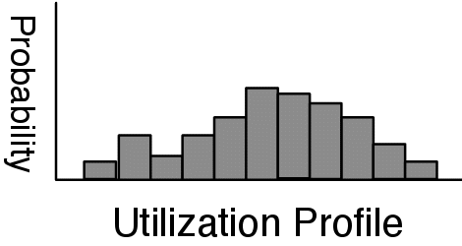
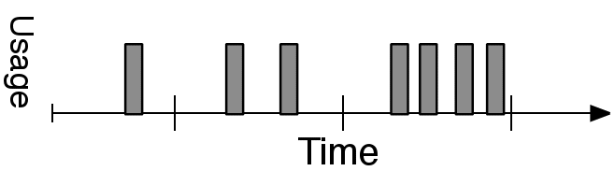
Resource Profiling – How much?
How much of each resource to give a VM
Create distribution from time series
Provision to meet peaks of recent workload
Black box: generally know when resources are not enough
What to do if utilization is at 100%?
Gray-box
Request level knowledge can help
Can use application models to determine requirements
Utilization Profile
Historical data
Probability
% Utilization
Notes:
A hotspot is triggered because the utilization of one or more of the virtual machines running on a server is increasing. As a result, we need to compute a new resource profile for those virtual machines which tells how much of each resource the VMs need. We do this by creating a distribution of resource utilizations based on historical data, by default we look at the previous 2 hours to compute the distribution. We then provision the virtual machine based on the 90th percentile of the observed utilization.
In the graybox scheme, we can sometimes use knowledge about the application to do better than this. By looking at the incoming requests it may be possible to model the expected resource requirements. As I’ll show later, this is particularly useful when resource utilization is saturated – in the black-box case you only know that you don’t have enough, but you don’t know how much more of the resource you require. With an application model you might be able to more accurately predict the requirement.

Slide 67
Determining Placement – Where to?
Migrate VMs from overloaded to underloaded servers
Use Volume to find most loaded servers
Captures load on multiple resource dimensions
Highly loaded servers are targeted first
Migrations incur overhead
Migration cost determined by RAM (memory footprint of VM)
Avoid expense to move large RAM footprint if possible.
Migrate the VM with highest Volume/RAM ratio
Volume =
1
1
1
*
*
net
1-cpu
1-net
1-mem
cpu
mem
Maximize the amount of load transferred while
minimizing the overhead of migrations
Notes:
Once we have computed the amount of resources required by each VM, we know need to determine a new placement for them so that they can actually obtain those resources. The basic idea is that we want to migrate virtual machines from the most overloaded servers to the least loaded servers. We need a metric which captures “load” along multiple resource dimensions. To do this, we propose the notion of the virtual machine’s volume which is computed as shown here. CPU, Net and Mem are the total resource utilizations on the server. The idea is that any server which has very high utilization for one or more resources will have a high Volume. Further, as utilization approaches saturation, its volume increases even faster.
We can define Volume for both a physical machine and for a virtual machine in which case CPU, net and ram are the respective utilizations for that VM.
The goal of our algorithm then is to take the set of physical servers which are considered to be overloaded based on the hotspot detection module and sort them by the volume metric. We then take the highest volume physical machine and migrate the virtual machine with the highest Volume/RAM ratio. We have found that the length of a migration is dependent on the amount of memory allocated to the virtual machine, so moving VMs with lower memory footprints incurs less overhead. The idea is that by using this ratio we are maximizing the amount of load displaced per megabyte of data transferred.

Slide 68
Placement Algorithm
First try migrations
Displace VMs from high Volume servers
Use Volume/RAM to minimize overhead
Don’t create new hotspots!
What if high average load in system?
Swap if necessary
Swap a high Volume VM for a low Volume one
Requires 3 migrations
Can’t support both at once
PM1
PM2
VM1
VM2
VM3
VM4
Migration
Spare
PM1
PM2
Swaps increase the number of hotspots we can resolve
VM1
VM2
VM5
VM3
VM4
Swap
Notes:
First we try to do migrations as I’ve just described, but depending on the current mapping of virtual to physical servers, it may not always be possible to resolve all hotspots with just migrations. If there are still overloaded physical machines after all migrations have been examined, then we try to swap a VM from a heavily loaded server with one from a lightly loaded server. Swaps have an extra cost because generally they actually require 3 migrations since an intermediate node must be used to ensure that both VMs aren’t running on one server at a time.
Also, we never initiate a migration or a swap if the destination of the migration might become overloaded based on our predicted resource utilizations.

Slide 69
Outline
Introduction & Motivation
System Overview
When? How much? And Where to?
Implementation and Evaluation
Conclusions

Slide 70
Implementation
Use Xen 3.0.2-3 virtualization software
Testbed of twenty 2.4Ghz P4 servers
Apache 2.0.54, PHP 4.3.10, MySQL 4.0.24
Synthetic PHP applications
RUBiS – multi-tier ebay-like web application
Notes:
We have implemented Sandpiper using the Xen virtualization software and have tested it on a prototype data center composed of twenty Pentium 4 class servers. We have used a mixture of synthetic PHP applications driven by httperf workloads and some realistic data center applications like RUBiS, which is an ebay-like web application.

Slide 71
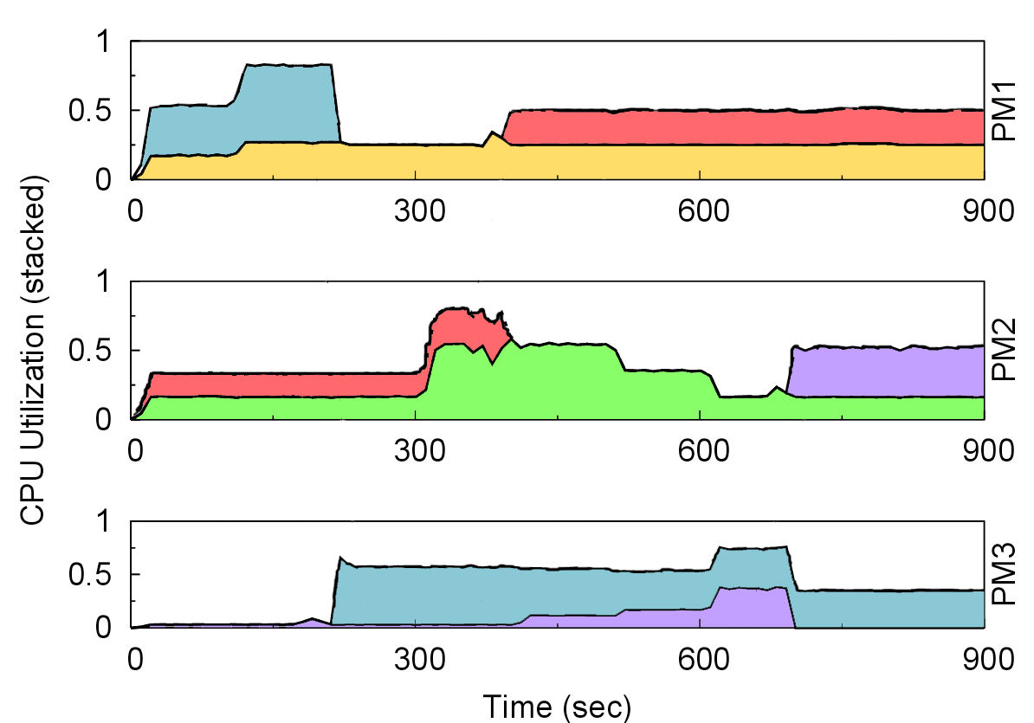
Migration Effectiveness
3 Physical servers, 5 virtual machines
VMs serve CPU intensive PHP scripts
Migration triggered when CPU usage exceeds 75%
Sandpiper detects and responds to 3 hotspots
PM 1
CPU Usage (stacked)
PM 2
PM 3
Notes:
Here we see an example of Sandpiper in action. There are three physical servers represented by each of the axis, and 5 virtual machines which are each a different color in the graph. The plot shows the CPU utilization of each virtual machine, and they are stacked so that the top line in each plot is the total utilization for that physical machine.
You can see that Sandpiper is able to detect 3 different hotspots during the experiment and that it successfully migrates a VM in each case to balance the load.

Slide 72
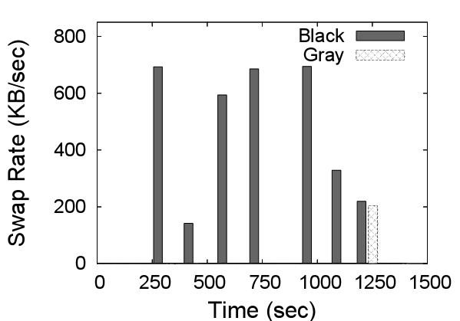
Memory Hotspots
Virtual machine runs SpecJBB benchmark
Memory utilization increases over time
Black-box increases VM memory allocation by 32MB if page-swapping is observed
Gray-box maintains 32 MB free
Significantly reduces page-swapping
Gray-box can improve application
performance by proactively increasing allocation
Notes:
Here we compare the ability of the black and gray systems to deal with memory hotspots. The black-box system responds to swapping by increasing the VM’s memory allocation by 32MB. The gray-box system gets data from the OS and tries to always maintain a buffer of 32MB free at all times.
We run the SpecJBB benchmark which is a very memory intensive application. As the benchmark proceeds it requires increasingly large amounts of memory. The first plot shows the amount of memory allocated to the VM running the application in each system and you can see that the gray approach generally leads the black approach in allocating memory. The second plot shows when swapping occurs in the two systems. Since the black-box system is reactive, there is swapping throughout the experiment. In the gray-box approach there is only one time when any swapping occurs, and in fact, if the buffer of free memory was increased, the gray-box system could be made to cause no swapping at all.
This shows one of the benefits of having gray-box data – it allows for proactive resource adjustments which are not always possible with only black-box information.

Slide 73
Data Center Prototype
16 server cluster runs realistic data center applications on 35 virtual machines
6 servers (14 VMs) become simultaneously overloaded
4 CPU hotspots and 2 network hotspots
Sandpiper eliminates all hotspots in four minutes
Uses 7 migrations and 2 swaps
Despite migration overhead, VMs see fewer periods of overload
Notes:
In this experiment we have a much larger deployment of virtual machines – we use 16 physical servers running a total of 35 virtual machines. The VMs run a mix of synthetic benchmark applications and RUBiS e-commerce sites. In this scenario we emulate a large overload scenario where the load on 14 VMs increases enough to overload 6 of the physical machines with a mix of CPU and network hotspots.
Sandpiper is able to detect these simultaneous hotspots and resolve them through a total of 7 migrations and 2 swaps, taking a bit less than 4 minutes including the detection time. The plot here shows the number of overloaded servers with Sandpiper running, as well as with a static allocation. It shows that during the resolution period the overhead caused by migrations can actually make Sandpiper have brief periods where there are more overloaded servers than in the static case, but also that by the 60th time interval Sandpiper has balanced the load so that no servers are overloaded. The second chart shows that even during the overload resolution period, despite the brief load spikes due to migration overhead, there are significantly fewer periods spent overloaded. Particularly, the amount of sustained overload, that is when a physical server spends 3 consecutive intervals overloaded, is significantly reduced.

Slide 74
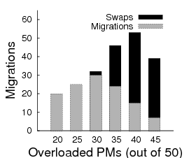
Stability During Overload
Predict future usage
Will not migrate if destination could become overloaded
Each set of migrations must eliminate a hotspot
Algorithm only performs bounded number of migrations
Measured Predicted
Notes:
Finally, I’ll describe two of the ways which Sandpiper tries to remain stable even during periods of high overload. In our design we were careful to prevent Sandpiper from initiating migrations which would cause subsequent migrations or could lead to thrashing where a VM keeps being moved from server to server.
The first step is that we use prediction techniques to extrapolate what the resource usage of a server is likely to be a few minutes in the future. This means that in the example I show here, if we are trying to select the least loaded physical machine as a destination for a migration, we will pick PM2, since our forecasting data predicts that the load on PM1 is increasing. We try to be conservative about where we place virtual machines, and we will never initiate a migration if we think the destination might become overloaded as a result. If the load on all servers is high and there is no viable migration destination, then we don’t start any migrations because the overhead would only make the situation worse.
We also will only initiate a set of migrations if it will eliminate the hotspot on the source server. Combined with our previous rule, this means that there is a bounded number of migrations which we will attempt. The second chart shows a simulation where the number of overloaded servers was varied and the number of migrations which Sandpiper will attempt before giving up is plotted. You can see that the number of migrations only increases up to a certain point, and that after the average load on all servers passes some threshold, the number of migrations which will be initiated decreases.

Slide 75
Related Work
Menasce and Bennani 2006
Single server resource management
VIOLIN and Virtuoso
Use virtualization for dynamic resource control in grid computing environments
Shirako
Migration used to meet resource policies determined by application owners
VMware Distributed Resource Scheduler
Automatically migrates VMs to ensure they receive their resource quota
Notes:
Before I conclude I want to mention some related systems which are working in this area. There has been some work on resource management, particularly CPU scheduling, for virtual machines running on a single physical server.
There is also the Shirako system out of Duke which provides a dynamic resource control plane for grid computing environments where users lease resources from providers.
VMware has a product called the Distributed Resource Scheduler which uses automated VM migration to ensure that each virtual machine receives the resources which it has been allocated.

Slide 76
Summary
Virtual Machine migration is a viable tool for dynamic data center provisioning
Sandpiper can rapidly detect and eliminate hotspots while treating each VM as a black-box
Gray-Box information can improve performance in some scenarios
Proactive memory allocations
Future work
Improved black-box memory monitoring
Support for replicated services
Notes:
To summarize this project, we’ve shown that migration is a viable tool for dynamic provisioning. We’ve demonstrated that even with pretty basic resource utilization information, you can still effectively detect and eliminate hotspots.
Finally, we’ve shown some of the benefits that you get from having extra inside information. Mainly that it allows for more proactive memory allocation and also has benefits when a server becomes severely overloaded and utilization becomes saturated.

Slide 77
Virtual Machine Files

Slide 78
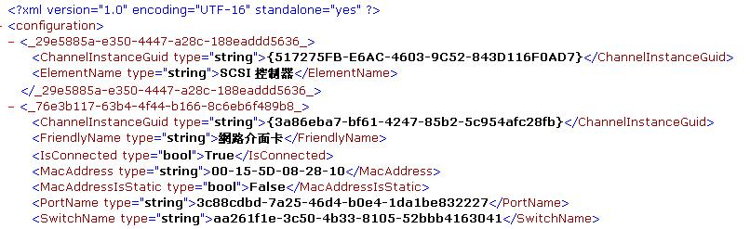
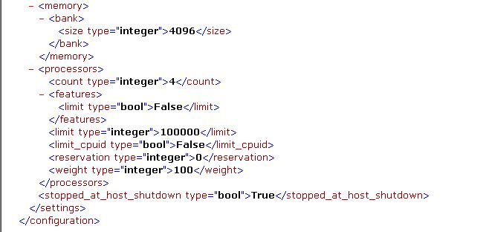
File format(1)
.XML File
Save VM Configuration details
Named with the GUID

Slide 79
File format(2)
.BIN files
This file contains the memory of a virtual machine or snapshot that is in a saved state(running programs, data for those programs, word processing documents you are viewing, etc.)
.VSV files
This file contains the saved state from the devices associated with the virtual machine.

Slide 80
File format(3)
.Vhd files
These are the virtual hard disk files for the virtual machine(save things such as files, folders, file system and disk partitions)
.avhd files
These are the differencing disk files used for virtual machine snapshots

